Slide 1
CST2550 - 2025
Software Engineering and Management
Week 11: Implementing AI Models in C# Applications
Ahmed Eissa
a.eissa@mdx.ac.uk

Slide 2
Learning Objectives
Understand AI/ML fundamentals (Core concepts)
Learn ML.NET framework (Microsoft's ML platform)
Implement AI models in C# (Practical implementation)
Integrate pre-trained models (Using existing AI)

Slide 3
1. Introduction

Slide 4
Artificial Intelligence Overview
What is Artificial Intelligence? (Computer systems performing intelligent tasks)
  Machine learning (Learning from data)
  Deep learning (Neural network-based learning)
  Natural language processing (Understanding human language)
  Computer vision (Understanding images)
AI in modern applications:
  Recommendation systems (Personalised suggestions)
  Fraud detection (Security applications)
  Predictive analytics (Future trend forecasting)
  Image recognition (Visual understanding)

Slide 5
Machine Learning Fundamentals
Types of machine learning:
  Supervised learning (Learning with labelled data)
  Unsupervised learning (Finding patterns without labels)
  Reinforcement learning (Learning through rewards)
Key concepts:
  Training data (Data used to teach the model)
  Features (Input variables)
  Labels (Output/target variables)
  Model (Mathematical representation of patterns)

Slide 6
ML.NET Framework
Microsoft's machine learning framework (Cross-platform ML for .NET)
Key features:
  Cross-platform support (Windows, Linux, macOS)
  Integration with existing .NET applications (Seamless integration)
  Support for multiple ML tasks (Classification, regression, clustering)
  Model training and deployment (Complete ML pipeline)

Slide 7
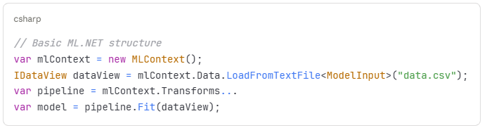
ML.NET Architecture
Components: MLContext (Entry point for ML operations)
  DataView (Data representation)
  Trainers (Algorithms for model training)
  Transformers (Data preprocessing)
  Model (Trained ML model)

Slide 8
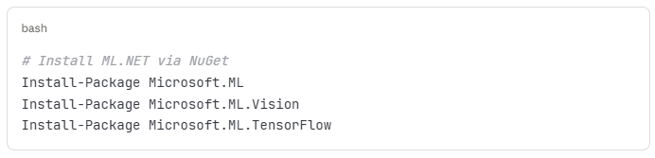
Setting Up ML.NET
Installation process: Install via NuGet Package Manager
Required packages:
  Microsoft.ML (Core package)
  Microsoft.ML.Vision (Image processing)
  Microsoft.ML.TensorFlow (TensorFlow integration)

Slide 9
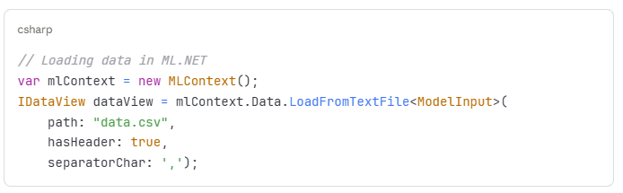
Data Preparation
Importance of data quality (Good data leads to good models)
Steps in data preparation:
  Data collection (Gathering relevant data)
  Data cleaning (Removing errors and inconsistencies)
  Feature engineering (Creating meaningful input variables)
  Data splitting (Training, validation, test sets)

Slide 10
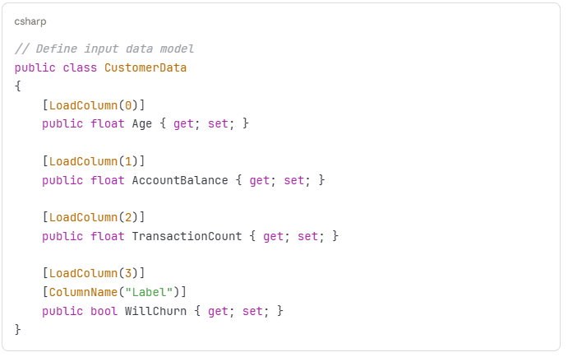
Classification Task Example
Problem: Predict customer churn (Will customer leave?)
Approach: Binary classification (Yes/No prediction)

Slide 11
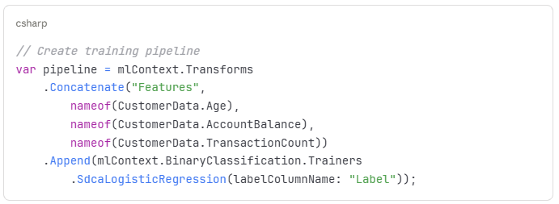
Building a Training Pipeline
Pipeline components (Sequential data transformations) Data transformations (Preparing data for training)
Feature concatenation (Combining features)
Algorithm selection (Choosing appropriate trainer)

Slide 12
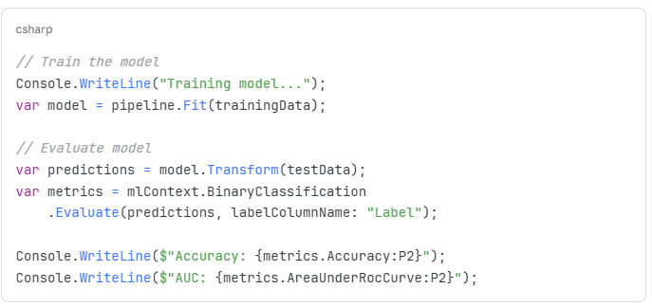
Training the Model
Training process (Learning patterns from data)
  Feed data through pipeline (Process training data)
  Optimize model parameters (Improve accuracy)
  Validate results (Check model performance)

Slide 13
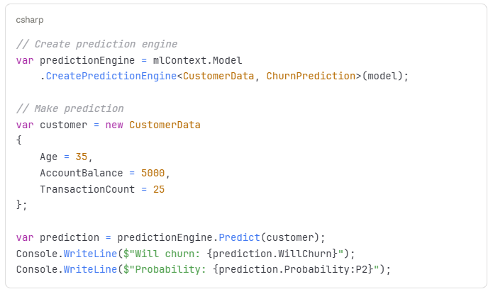
Making Predictions
Using trained model (Applying model to new data)
  Create prediction engine (Tool for making predictions)
  Input new data (Provide features)
  Get predictions (Receive model output)

Slide 14
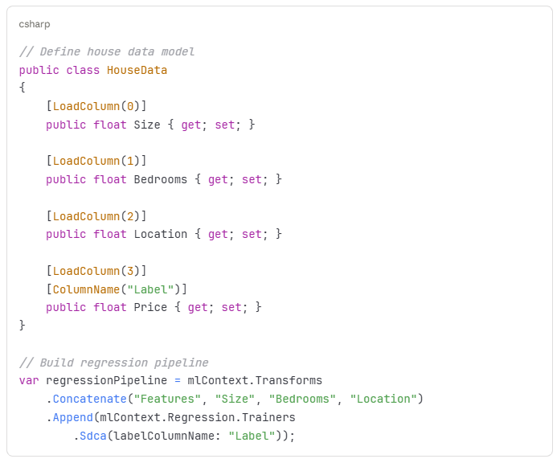
Regression Example
Problem: Predict house prices (Numerical value prediction)
Approach: Regression analysis (Continuous value prediction)

Slide 15
Working with Pre-trained Models
Benefits of pre-trained models:
  No training required (Use immediately)
  High accuracy (Trained on large datasets)
  Time and cost efficient (Saves resources)
Examples:
  Image classification (Identifying objects in images)
  Object detection (Locating objects in images)
  Text analysis (Understanding text content)

Slide 16
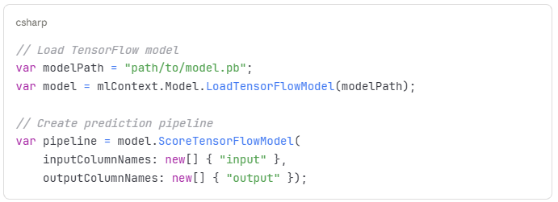
Using TensorFlow Models in C#
Integration with TensorFlow (Popular deep learning framework)
Steps:
  Load pre-trained model (Import existing model)
  Prepare input data (Format data correctly)
  Run inference (Get predictions)
  Process results (Interpret output)

Slide 17
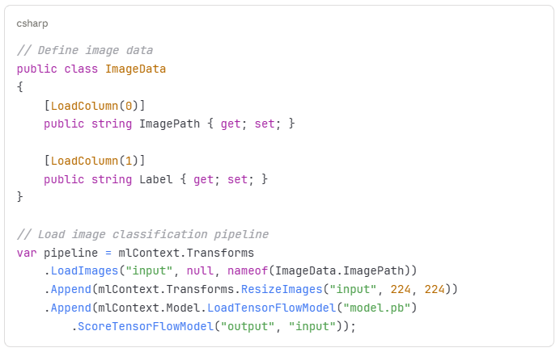
Image Classification Example
Problem: Classify images into categories (Image recognition)
Using pre-trained models (Transfer learning approach)

Slide 18
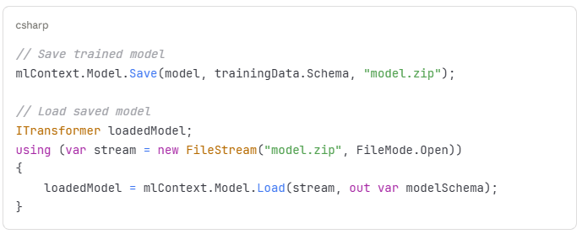
Model Deployment
Saving trained models (Persist for future use)
  Serialisation (Convert to file format)
  Version control (Track model versions)
  Storage considerations (File size and location)

Slide 19
Best Practices
Model development guidelines:
  Start with simple models (Baseline performance)
  Use appropriate evaluation metrics (Measure correctly)
  Cross-validate results (Ensure reliability)
  Monitor model performance (Track over time)
Production considerations:
  Model versioning (Track changes)
  Performance optimisation (Speed improvements)
  Error handling (Graceful failures)
  Security considerations (Protect data and models)

Slide 20
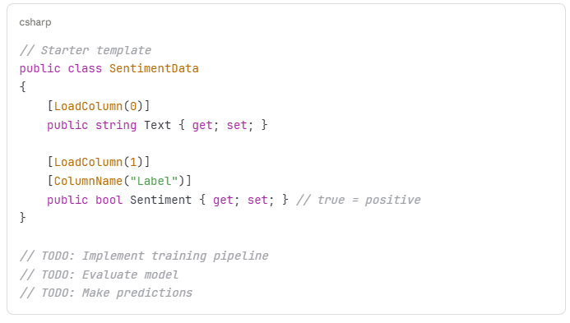
Practical Exercise
Create a sentiment analysis system that:
  Loads text data (Customer reviews)
  Trains a classification model (Positive/negative sentiment)
  Evaluates model performance (Check accuracy)
  Makes predictions on new text (Classify new reviews)

Slide 21
Summary and Resources
Key takeaways:
  ML.NET enables AI in C# applications (Native .NET integration)
  Multiple ML tasks supported (Classification, regression, clustering)
  Pre-trained models available (Quick implementation)
  Production-ready deployment (Enterprise applications)
Resources:
  ML.NET Documentation (https://docs.microsoft.com/ml-net)
  ML.NET Samples (GitHub repository)
  Azure Machine Learning (Cloud-based ML)
  TensorFlow.NET (Deep learning in .NET)
Next steps:
  Explore different ML algorithms (Broaden knowledge)
  Experiment with real datasets (Practical experience)
  Build end-to-end ML applications (Complete projects)
  Consider cloud-based ML services (Scalable solutions)

Slide 22
Next Week (Final Week)
Implementing AI Agents in C# Applications

